Slide 1
CLOUD ENGINEERING INTERNSHIP
NAME: HEMALALITHA M
REGISTER NO: 22IT036
DEPT &YEAR: INFORMATION TECHNOLOGY & III YEAR
MENTOR: MOHANKUMAR GANDHI
COMPANY NAME: AVOHI INFO TECH

Slide 2
INTRODUCTION
During my month-long tenure at Avohi Info Tech, I had the opportunity to explore the intricacies of modern Cloud technologies firsthand, gaining practical insights that complemented my academic studies.
Throughout this valuable experience, I focused on mastering essential aspects such as Cloud Computing Concepts, Cloud Platform Knowledge, Migrations, Virtualization, Containerization, Networking Basics, Security Principles, Scripting, Automation, Monitoring, Performance Management, Troubleshooting, and the importance of Continuous Learning and Adaptability.
This internship not only allowed me to delve deeply into various aspects of cloud engineering but also exposed me to industry-leading practices, collaborative workflows, and state-of-the-art tools.

Slide 3
OBJECTIVE
During my internship at Avohi Info Tech, spanning a month, I immersed myself in the dynamic realm of modern Cloud technologies, transcending theoretical concepts to acquire hands-on experience that fortified my academic foundation.
I diligently explored diverse facets of cloud engineering, from understanding fundamental Cloud Computing Concepts to mastering Cloud Platforms, Migrations, Virtualization, Containerization, Networking Fundamentals, Security Principles, Scripting, Automation, Monitoring, Performance Management, Troubleshooting, and the imperative of Continuous Learning and Adaptability.
I actively engaged with cutting-edge tools and methodologies, gaining insights into optimizing cloud infrastructures for scalability, resilience, and security. Now equipped with a robust skill set and a passion for innovation, I am eager to leverage my internship learnings to contribute effectively to transformative IT projects.

Slide 4
Literature survey
Cloud migration involves the transfer of organizational data, applications, and services from on-premises infrastructure to cloud environments.
Research highlights motivations such as cost savings, scalability, and agility (Gartner, 2020).
Effective strategies emphasize comprehensive assessment, workload prioritization, and governance (IBM, 2019).
Technical considerations include architectural patterns, containerization, and network optimization (Armbrust et al., 2010; Felter et al., 2015; Chowdhury and Boutaba, 2010), ensuring smooth transition and optimized performance

Slide 5
Project Challenges in existing research
Project challenges in existing research on Azure migration primarily revolve around several key aspects.
Firstly, ensuring compatibility and seamless integration with existing on-premises infrastructure and applications poses a significant hurdle (Microsoft Azure, 2020). This includes addressing dependencies, data transfer complexities, and ensuring minimal disruption to ongoing operations.
Secondly, managing security risks, including data protection, compliance with regulatory requirements, and safeguarding against cyber threats, remains critical throughout the migration process (Microsoft Azure, 2020).
Addressing these challenges demands a comprehensive approach, involving thorough assessment, strategic planning, and ongoing monitoring to achieve successful migration and maximize the benefits of Azure cloud services

Slide 6
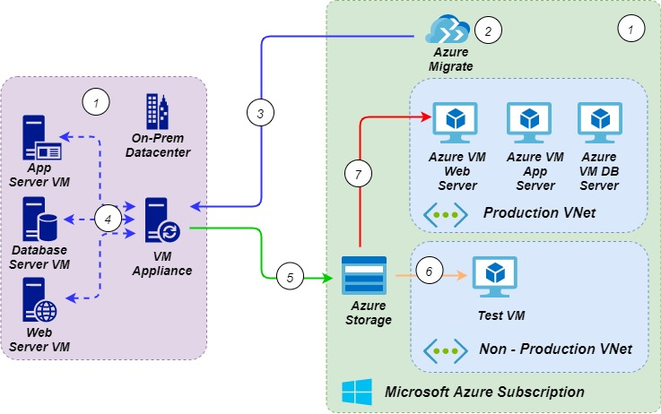
project Proposed solution with architecture diagram
Migration of on-premises VMware virtual machines to Microsoft azure cloud

Slide 7
project working methodology & detailed explanation
1. On-premises source virtual machines for migration to Azure cloud
2. Using Azure Migrate for On-premises VM Discovery and Assessment followed by Migration
Installation of VM Appliance (OVA (Open Virtual Appliance) template or Zip file (install using
PowerShell with admin rights))
4. Installed Appliance will perform Discovery and Assessment by gathering data
5. Installed Appliance will transfer the data to Azure Storage
6. Creating a test VM (data will get replicated in real time without affecting production servers)
7. Migrating VM to production (Actual source VMs should be shutdown to avoid data loss)

Slide 8
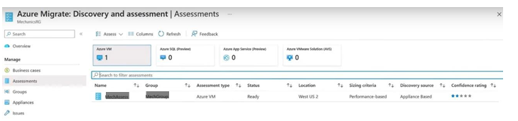
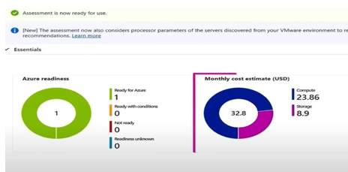
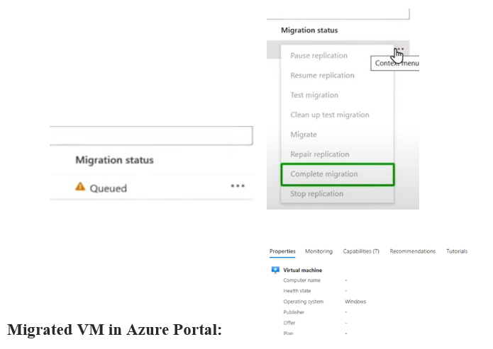
Sample output/Screen shots

Slide 9
Conclusion and Usage of Society
Azure cloud computing has profoundly influenced modern society by providing robust infrastructure and services that support a wide array of applications and industries.
Moreover, Azure's AI and machine learning capabilities empower organizations in healthcare, finance, and beyond to analyze vast datasets for insights that drive decision-making and improve customer experiences.
As Azure continues to evolve and expand its ecosystem, its role in shaping the digital landscape and advancing societal progress is set to grow, fostering a future where technology is more accessible, efficient, and transformative than ever before.

Slide 10
References
Microsoft Azure Official Learning:
https://learn.microsoft.com/en-us/training/modules/m365-azure-migrate-discover-assess/?source=recommendations
Microsoft Azure Official Study Guide for Microsoft Azure Administrator:
https://learn.microsoft.com/en-us/credentials/certifications/resources/study-guides/az-104
Microsoft Azure Official Study Guide for Designing Microsoft Azure Infrastructure Solutions:
https://learn.microsoft.com/en-us/credentials/certifications/resources/study-guides/az-305

Slide 11
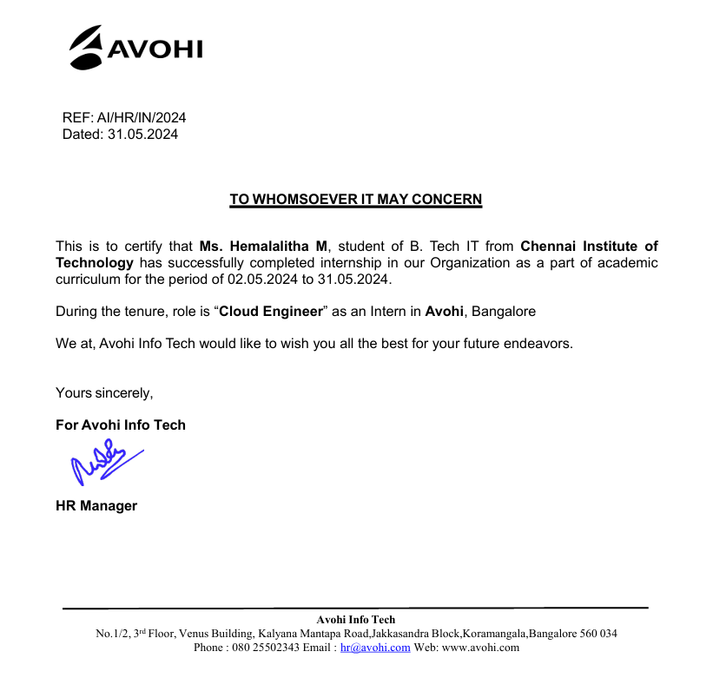
Internship completion certificate

